Slide 1
Symbolic Execution in Software Engineering
By
Xusheng Xiao
Xi Ge
Dayoung Lee
Towards
Partial fulfillment for Course 707

Slide 2
Overview
Introduction to symbolic execution
Test generation using dynamic symbolic execution
Path explosion problem
NP-complete problem
Greedy algorithm: fitness guided exploration
String constraint solver
Hampi: Context free grammar
Symbolic Grammar
Context free grammar

Slide 3
Symbolic Execution
Symbolic execution is the analysis of programs by tracking symbolic rather than actual values.
Symbolic execution is used to reason about all the inputs that take the same execution path through a program.
int main(int y)
{
y = 2 * y;
if (y == 4){
printf(“y == 4”);
}else {
printf(“y != 4”);
}
}
s
Example:
2 * s
2 * s == 4

Slide 4
Dynamic Symbolic Execution (DSE)
DSE is used to generate test inputs systematically
Choose next path
Solve
Execute&Monitor
void CoverMe(int[] a)
{
if (a == null) return;
if (a.Length > 0)
if (a[0] == 1234567890)
throw new Exception("bug");
}
Constraints to solve
a!=null
a!=null &&
a.Length>0
a!=null &&
a.Length>0 &&
a[0]==123456890
Input
null
{}
{0}
{123…}
Observed constraints
a==null
a!=null &&
!(a.Length>0)
a==null &&
a.Length>0 &&
a[0]!=1234567890
a==null &&
a.Length>0 &&
a[0]==1234567890
a==null
F
T
a.Length>0
Done: There is no path left.
F
T
a[0]==123…
F
T
4
Notes:
4
4
4

Slide 5
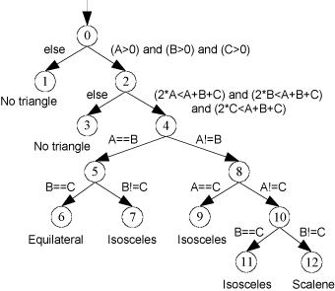
Path Explosion
CFG (control flow graph)
Each program under test could be modeled as CFG.
To achieve 100% path coverage is in NPC.

Slide 6
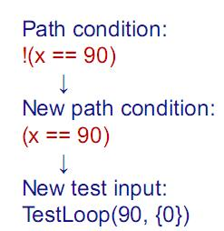
Path Explosion
Public bool TestLoop(int x, int[] y){
if(x==90){
for(int i=0; i<y.length;i++)
if(y[i]==15)
x++;
If(x==110)
return true;
}
return false;
}
TestLoop(0,{0})

Slide 7
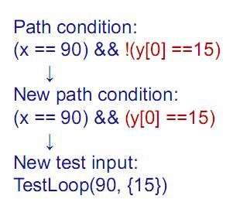
Path Explosion
Public bool TestLoop(int x, int[] y){
if(x==90){
for(int i=0; i<y.length;i++)
if(y[i]==15)
x++;
If(x==110)
return true;
}
return false;
}
TestLoop(90,{0})

Slide 8
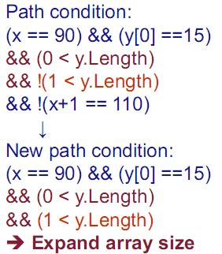
Path Explosion
Public bool TestLoop(int x, int[] y){
if(x==90){
for(int i=0; i<y.length;i++)
if(y[i]==15)
x++;
If(x==110)
return true;
}
return false;
}
TestLoop(90,{15})

Slide 9
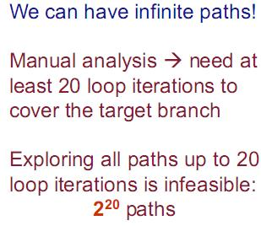
Path Explosion
Public bool TestLoop(int x, int[] y){
if(x==90){
for(int i=0; i<y.length;i++)
if(y[i]==15)
x++;
If(x==110)
return true;
}
return false;
}

Slide 10
Path Explosion
Public bool TestLoop(int x, int[] y){
if(x==90){
for(int i=0; i<y.length;i++)
if(y[i]==15)
x++;
If(x==110)
return true;
}
return false;
}

Slide 11
Fitness
Greedy algorithm: Fitness Guided Explosion
Fitness Function: Measure the current state and the goal state.
Public bool TestLoop(int x, int[] y){
if(x==90){
for(int i=0; i<y.length;i++)
if(y[i]==15)
x++;
If(x==110) Fitness function: |110-x|
return true;
}
return false;
}

Slide 12
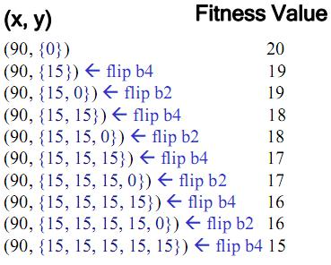
Fitness
Public bool TestLoop(int x, int[] y){
if(x==90){
for(int i=0; i<y.length;i++)
if(y[i]==15)
x++;
If(x==110)
return true;
}
return false;
}

Slide 13
String Constraint Solver
Testing tools could be reduced to constraint generation phase and constraint solving phase.
String constraint solvers are needed by testing string-manipulating programs
Web application
Hampi

Slide 14
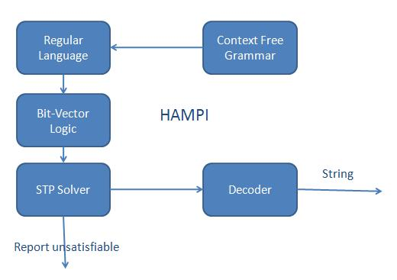
HAMPI

Slide 15
Input-Space Explosion
Programs such as Parsers that accept string inputs
Language of string inputs defined using context free grammars
Generation of string inputs to achieve 100% branch coverage causes input-space explosion

Slide 16
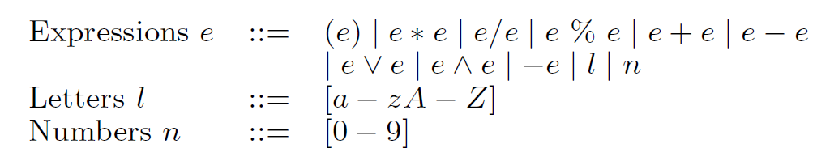
Example
The Grammar for SimpleCalc inputs is shown below:

Slide 17
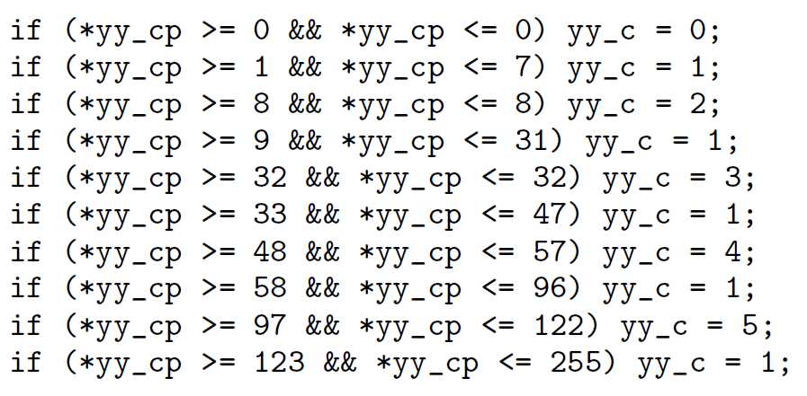
SimpleCalc Example
Boolean SimpleCalc (string str)
{ ….
…
}

Slide 18
Previous Approaches
Exhaustive Enumeration
Uses grammar and generates inputs exhaustively
Number of valid strings for size six: 187,765,078
Dynamic Symbolic Execution
Uses program source code and generates inputs
Number of inputs generated: 248,523

Slide 19
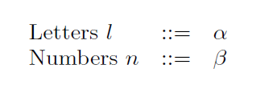
Symbolic Grammar
Uses both grammar and program source code
(1) The Grammar for SimpleCalc inputs is shown below:
(2) The Symbolic grammar for SimpleCalc inputs

Slide 20
Symbolic Grammar
Use Exhaustive Enumeration on Symbolic Grammar and generate inputs
Use dynamic symbolic execution for generating concrete values for symbolic values
Number of inputs generated: 6,611

Slide 21
Thank you!

